Slide 1

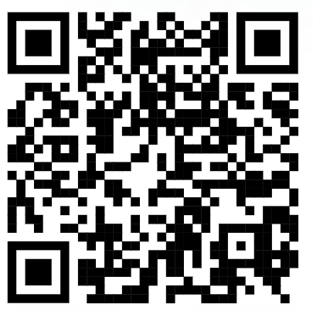
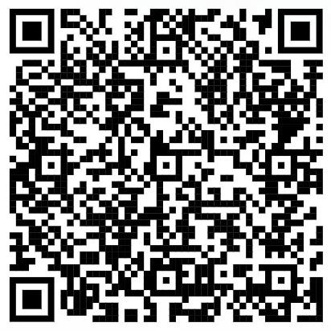

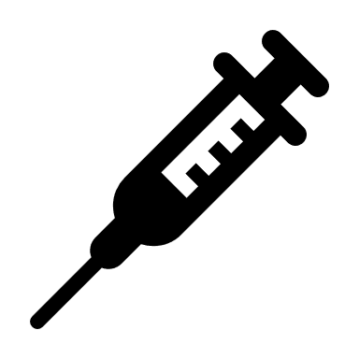

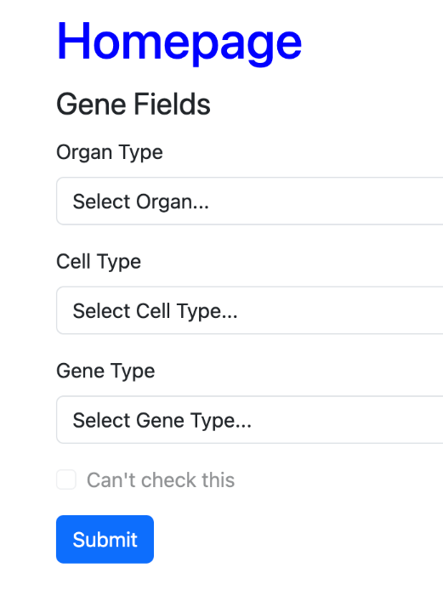

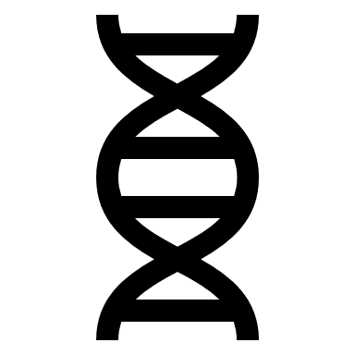
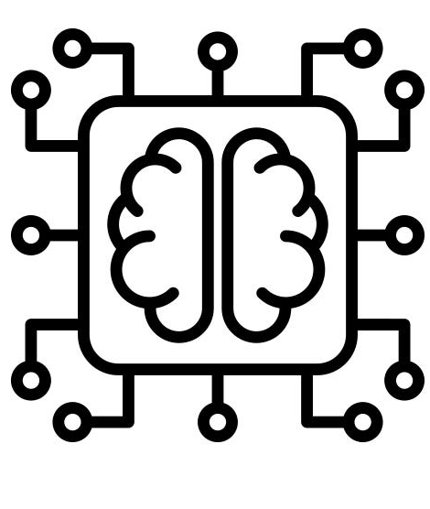

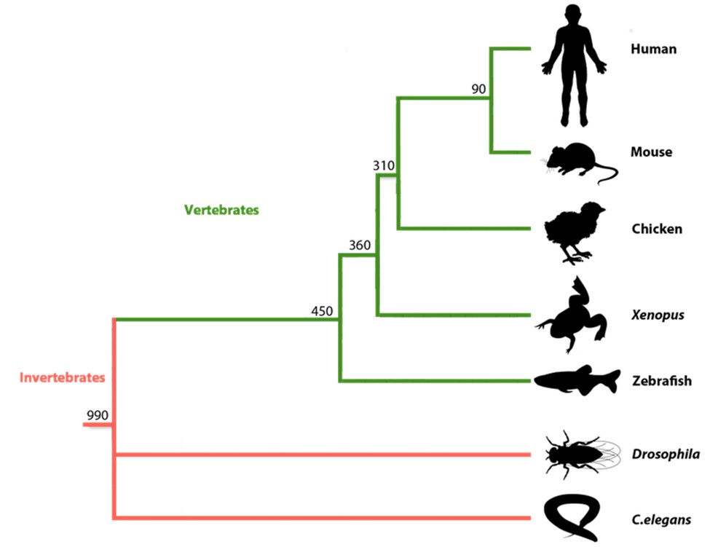


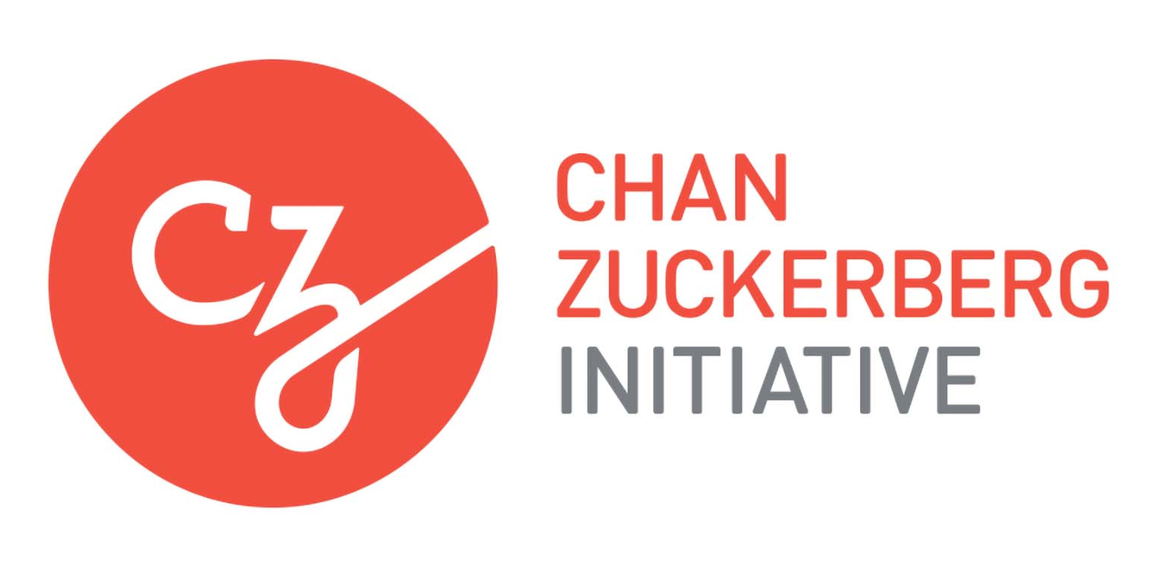
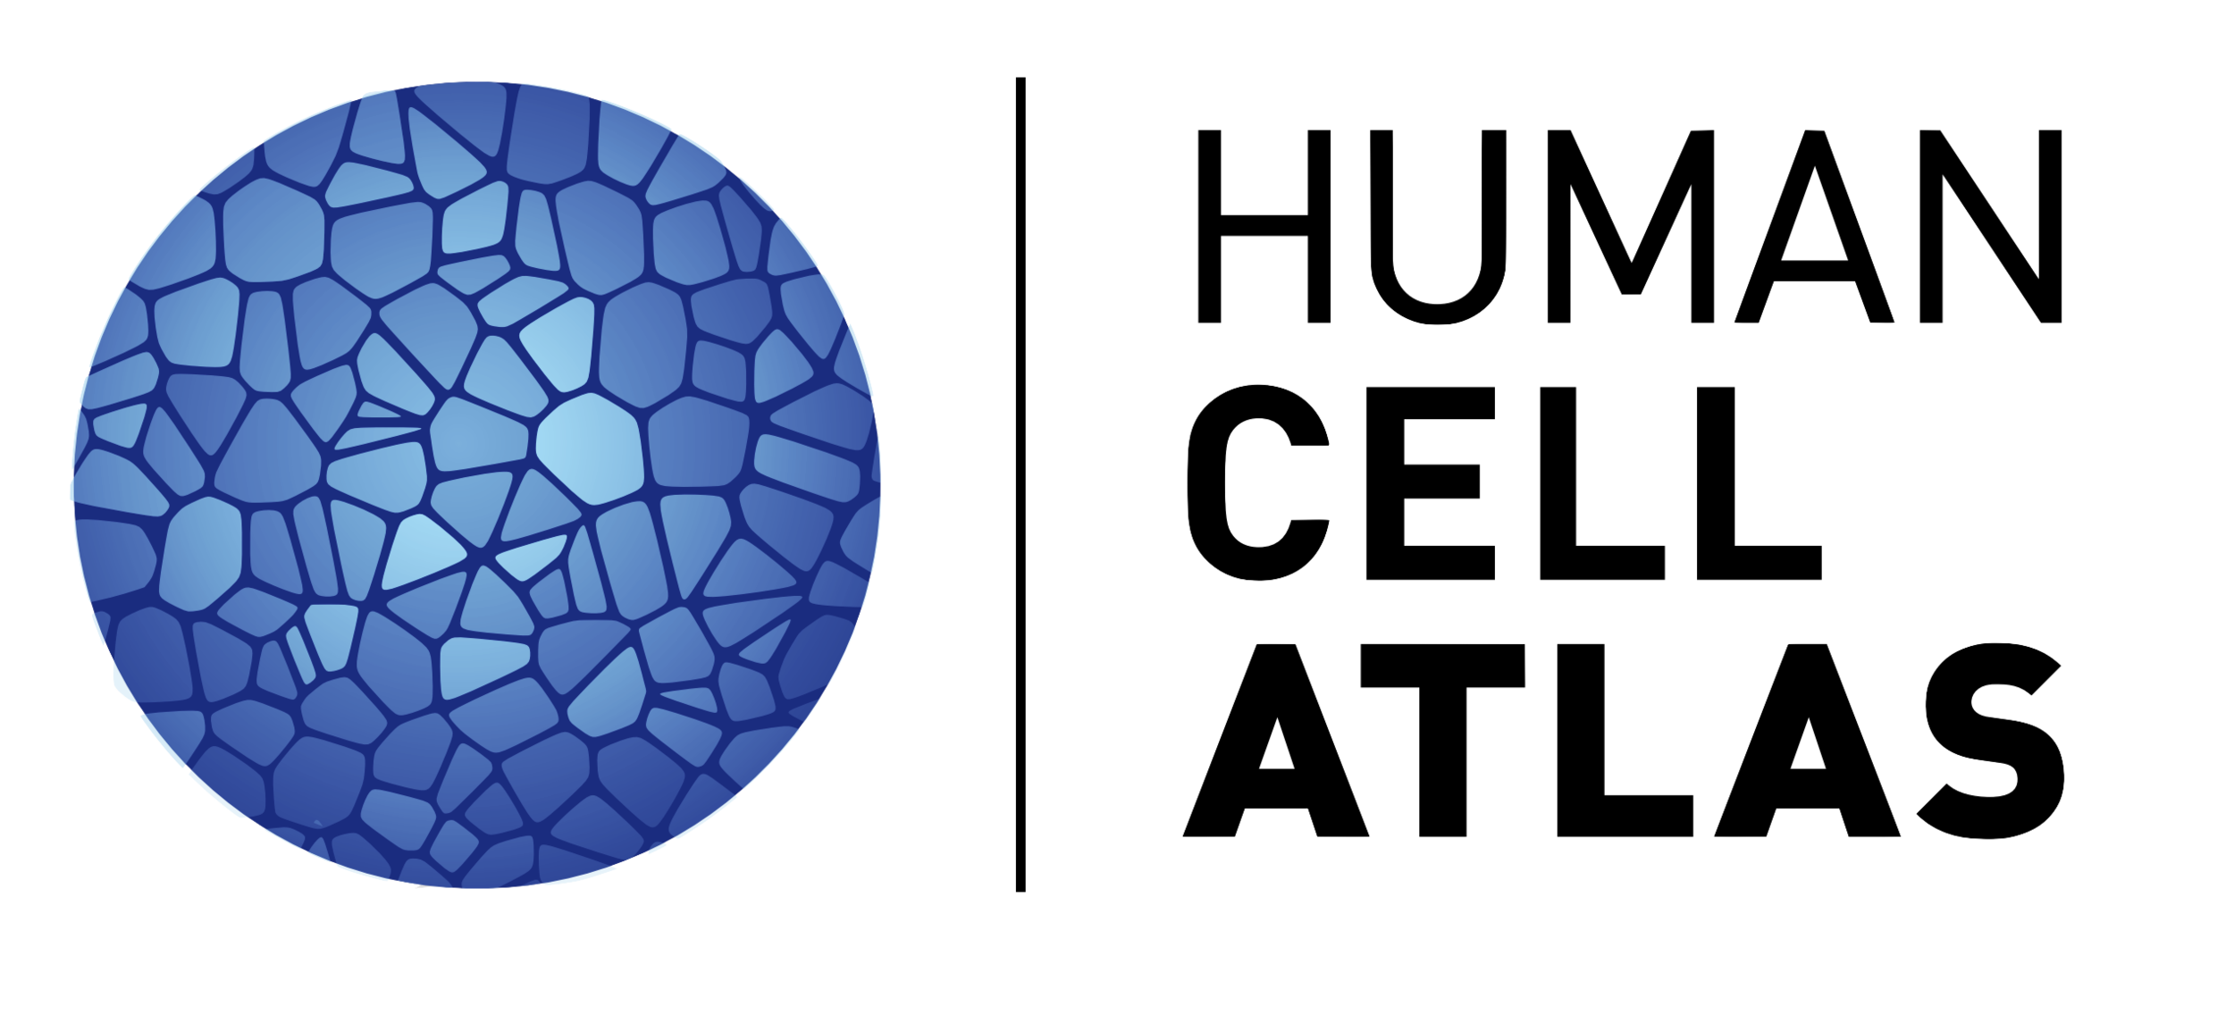

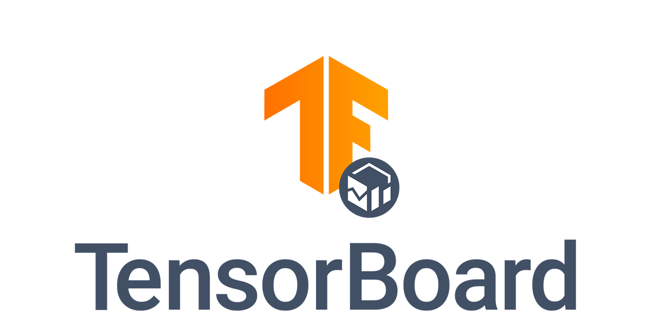
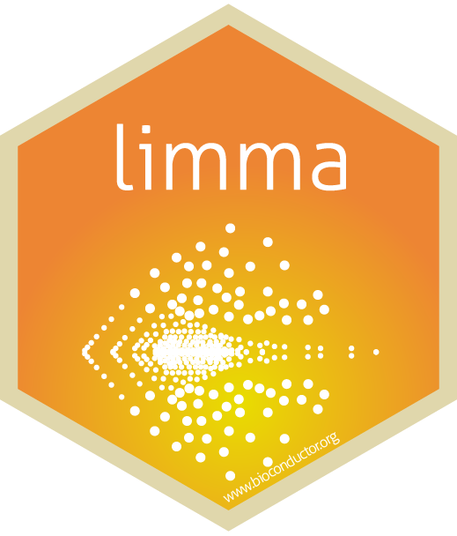
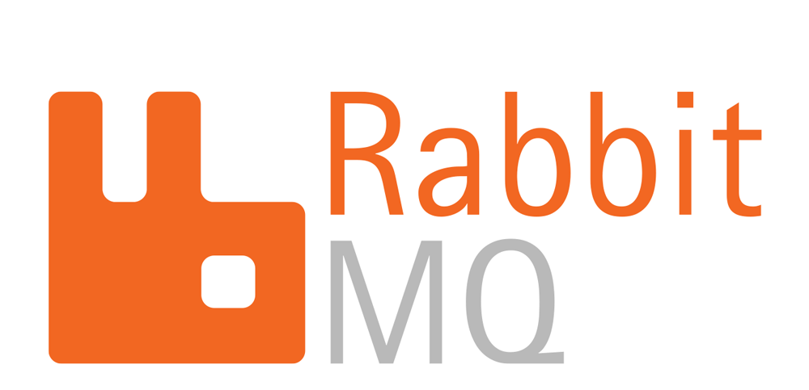



Building Artificial Intelligence Solutions
For Personalized Rare Disease Healthcare
Gautam Subedi¹, Unai Amilleta Gonzalez¹, GVSU GenAI Research Team, Zach DeBruine^{1,2}
¹Health Informatics and Bioinformatics Program, Grand Valley State University, MI
²Applied Computing Institute, Grand Valley State University, MI
debruinz@gvsu.edu
Abstract
Personalizing rare disease healthcare with AI
Prototyping a clinician-facing web application
Rare diseases often remain poorly understood or even undiagnosed despite the widespread adoption of whole-exome and whole-genome sequencing. This presents a major challenge for patients and their care providers, as rare diseases can have very complex clinical manifestations.
Our goal is to build AI that will provide personalized healthcare insights for rare disease patients by prioritizing clinical conditions for screening. This will facilitate more timely treatment and better quality of life.
Our approach is to train a generative AI model on human and mouse genetic data that will gain insights from models of human disease in mouse to predict the corresponding human phenotypes. Further, our model will broadly understand the rules of gene regulation and, when presented with gene expression data from a patient blood sample, can identify patterns of gene expression altered in disease and predict disease-equivalent data for every other human organ, cell type, or trained biological context.
This novel ability to generate disease data for comparison with healthy reference data will allow us to estimate the magnitude of effect of a disease in any given biological context, regardless of whether it has been measured.
Accessibility to our models is ensured through a web dashboard that will help clinicians easily use the model for proof-of-concept testing. Currently we are architecting and training our first full-scale models and anticipate testing on human samples later this year.
Historically, rare diseases are studied individually.
Artificial Intelligence can give insights into rare diseases collectively.
AI promises a breakthrough in personalized medicine.
We are developing open-source software using open-source software for our web application.
AI Model
AI Client
rare disease
patient
Check out our codebase on GitHub!
blood draw
dashboard of
results
Reference samples can be selected for comparison with rare disease samples based on standardized metadata in the curated CellCensus resource:
Cell type (>400 types)
Tissue/organ (>40 options)
Developmental Stage
Ancestry
Sex
…any other curated field in the Human Cell Atlas!
clinician
genomics assay
AI-generated “cell atlas” of disease patient
upload data
to web app
Ongoing work
How our AI model works
This project is in the early stages of development. To date, we have achieved stable training of our novel multimodal variational autoencoder architecture and are currently optimizing the architecture prior to training on the full dataset. In the meantime, we are:
Implementing functions for automatic report generation (summary statistics for dashboard outputs)
Architecting a computational pipeline for a web application that serves our AI model asynchronously
Implementing encryption, security, and privacy measures to appropriately handle sensitive patient data
A web application for AI-guided clinical care
Training an AI model to understand
human biology
Teaching this pre-trained AI model to understand
rare disease patient biology
Human Cell Atlas Data
Start with a variational autoencoder (VAE), the most popular generative AI architecture
this model generates “virtual” human cells
encode
μ
decode
Simulate rare disease by fine-tuning the VAE decoder to generate rare disease patient data
Then generate rare disease human virtual cells for any biological input human context
encode
σ
WT
μ
KO
(pred)
Acknowledgements
Train AI model on a large reference dataset
σ
Pre-trained AI Model
Append an encoder and decoder for each species on either end of the shared VAE
this model generates “virtual” cells with multiple species representations
DeBruine Lab
Tony Boos
Cardell Taylor
Aliah Lloyd
Marcos Diaz
Dat Nguyen
Skyler Ruiter
Seth Wolfgang
The GenAI Team
GVSU Applied
Computing Institute
Jonathan Engelsma
Paul Doyle
Linda Chamberlain
GVSU Information Technology
Cody Eding
Eric Bellmore
μ
Transfer knowledge from rare disease model organisms with multimodal cross-generation and fine-tuning
Given a mouse or fish model of rare disease, for example, fine-tune the model to predict disease in that organism, then put in healthy human samples to generate equivalent rare disease human virtual cells.
?
KO
(pred)
Patient Data
Fine-tune AI model to generate patient blood data from matched blood data from healthy donors
σ
μ
KO
(obs)
WT
σ
KO
(pred)
Fine-tuned AI model
Add adversarial feedback to the shared VAE encoder layers
This model processes information without
species-specific bias so that a discriminative neural network cannot tell which species the input came from.
?
Van Andel Institute
Andrew Pospisilik
Tim Triche
μ
Stefanos Apostle
Noah Kessler
Use fine-tuned AI model to generate equivalent patient data for more than just blood
σ
Summarize differences between generated disease data and generated healthy data for any two inputs:
Resample indefinitely by exploiting the Variational Autoencoder’s random sampler to increase statistical power
Generate p-values and effect sizes for magnitude of disease effect in different well-annotated input contexts (i.e. cell type, tissue, developmental stage, sex, ancestry)
Rank most affected contexts for prioritized presentation in the dashboard
Present findings interactively through a dynamic dashboard that allows for gene-level, cell-level, and metadata-level analysis.
Corewell Health
Jeremy Prokop
Surender Rajasekaran
Caleb Bupp
AI-generated
“Patient Cell Atlas”
Add adversarial feedback to the output species-specific decoders
This model generates such realistic virtual cells across species that a discriminative neural network cannot tell whether the outputs are real or generated
?
Summarize findings from generated patient data to draw clinically meaningful insights
real/ fake?
Funding
μ
real/ fake?
Summary Statistics
Clinical Insights
σ
real/ fake?
Chan Zuckerberg Initiative Single-Cell Data
Insights Grant: “High-Performance Data
Structures for Single-Cell Data Integration”
National Institutes of Health Transformative R01 “Genetic Mechanisms of Phenotypic Variability”
Grand Valley State University Presidential
Innovation Award: “AI for Rare Diseases”
On the back-end, patient data upload to our web app is transferred to a local compute instance where model fine-tuning is performed. The reference data is loaded and a high-performance matching algorithm is used across all healthy donor data. The model is queried on our HPC instances, followed by generation of summary statistics, which are then returned to the user.
open-source training data corpus | machine learning framework | machine learning model visualization | web application dynamic bindings | Bioinformatics data analysis | high-performance computing job manager

